Slide 1
Foreground-background separation in video
By Brian Nguyen & Anthony Nguyen

Slide 2
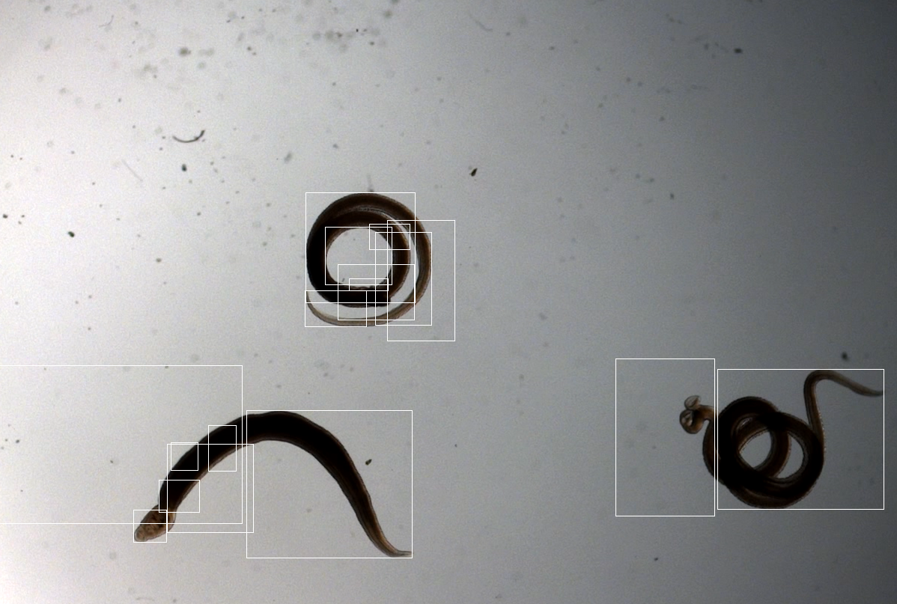
Previous proposal presentations
Wrong approach
Poor research and misunderstood of the project
Even with some detections, it’s not what should be required for the project
Doesn’t have a good background separation

Slide 3

Reapproach with better knowledge
Dig deeper and read more about the references article provided
It related to the color and brightness of the image.
Tried an image subtraction with a frame to understand the logic

Slide 4
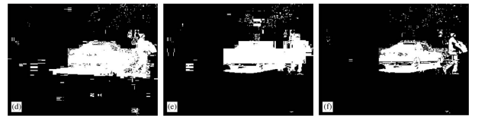
Using codebook background subtraction algorithm
Understand that codebook will be the best thing that work out for input pixel with RGB
Algorithm for Background subtraction that detection of foreground pixels is based on the absence of a matching codeword
Otherwise, it would be considered background
Codebook gives out the efficiency results for background subtraction as an example below in the article
MOG Kernel Codebook

Slide 5
Improvement
We decided to write codebook in Java and using Matlab, VSCode for the project
Understand that we need to separate the moving object and the background
Break down the video frame by frame
Isolate the foreground and background
Combined them back together into a mp4

Slide 6
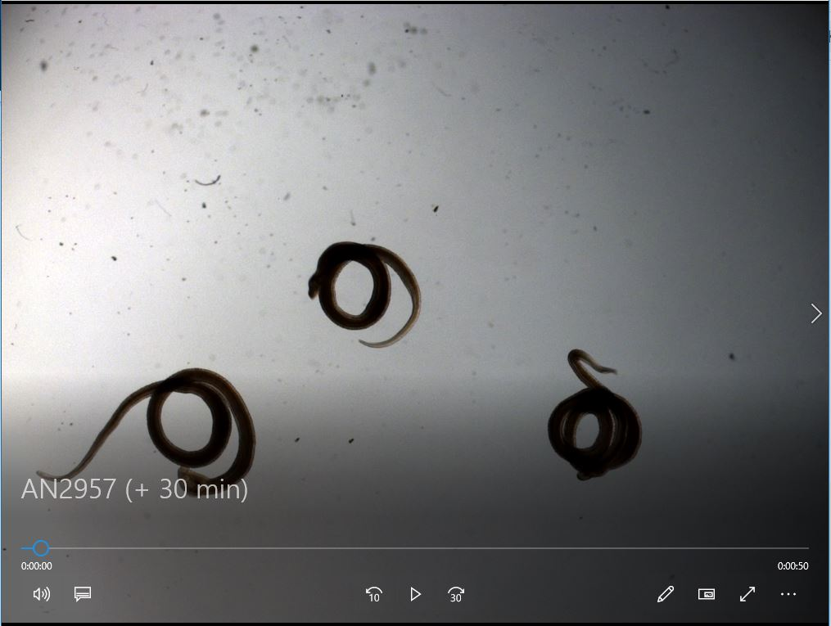

When the video was separated frame by frame, The video is 50 secs and once we were able to split it up, it was 307 pictures in bmp
We had to use matlab to convert the .mov to bmp
That way we are able to separate the foreground and the background

Slide 7
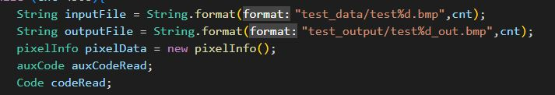
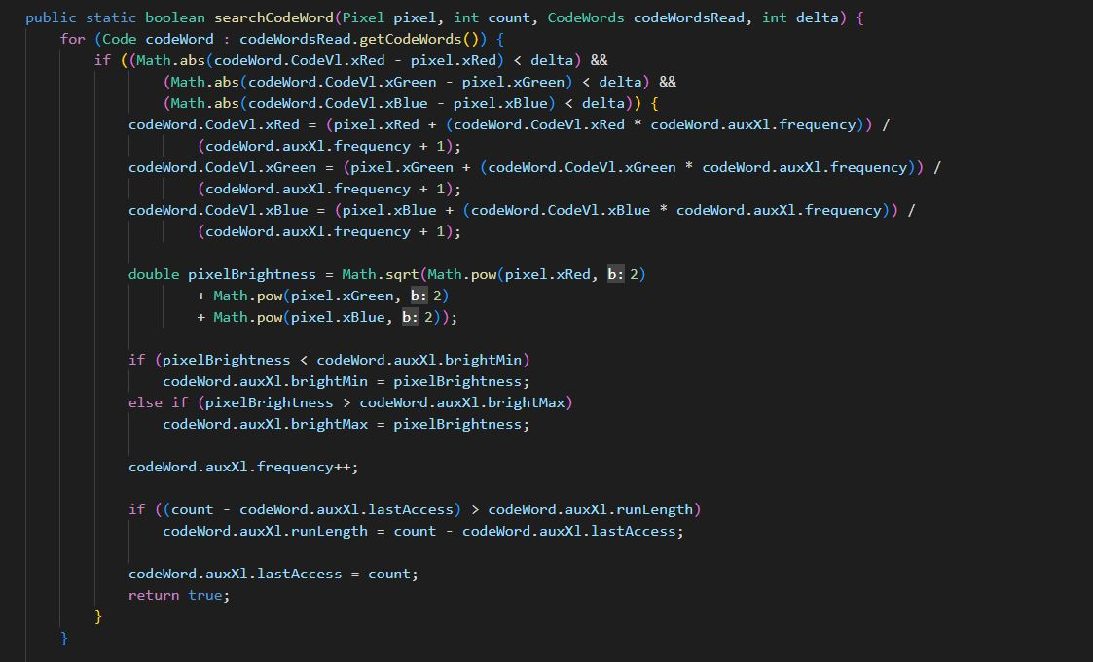

Slide 8

Early result & Difficulty
Detection results on a frame of the video
Foreground is clear to see what is the object
Background subtracted
The intensity of background still appeared
The foreground and background is separated. Though the left has higher intensity, we were unable to remove all of it.

Slide 9

Demo:

